Slide 1
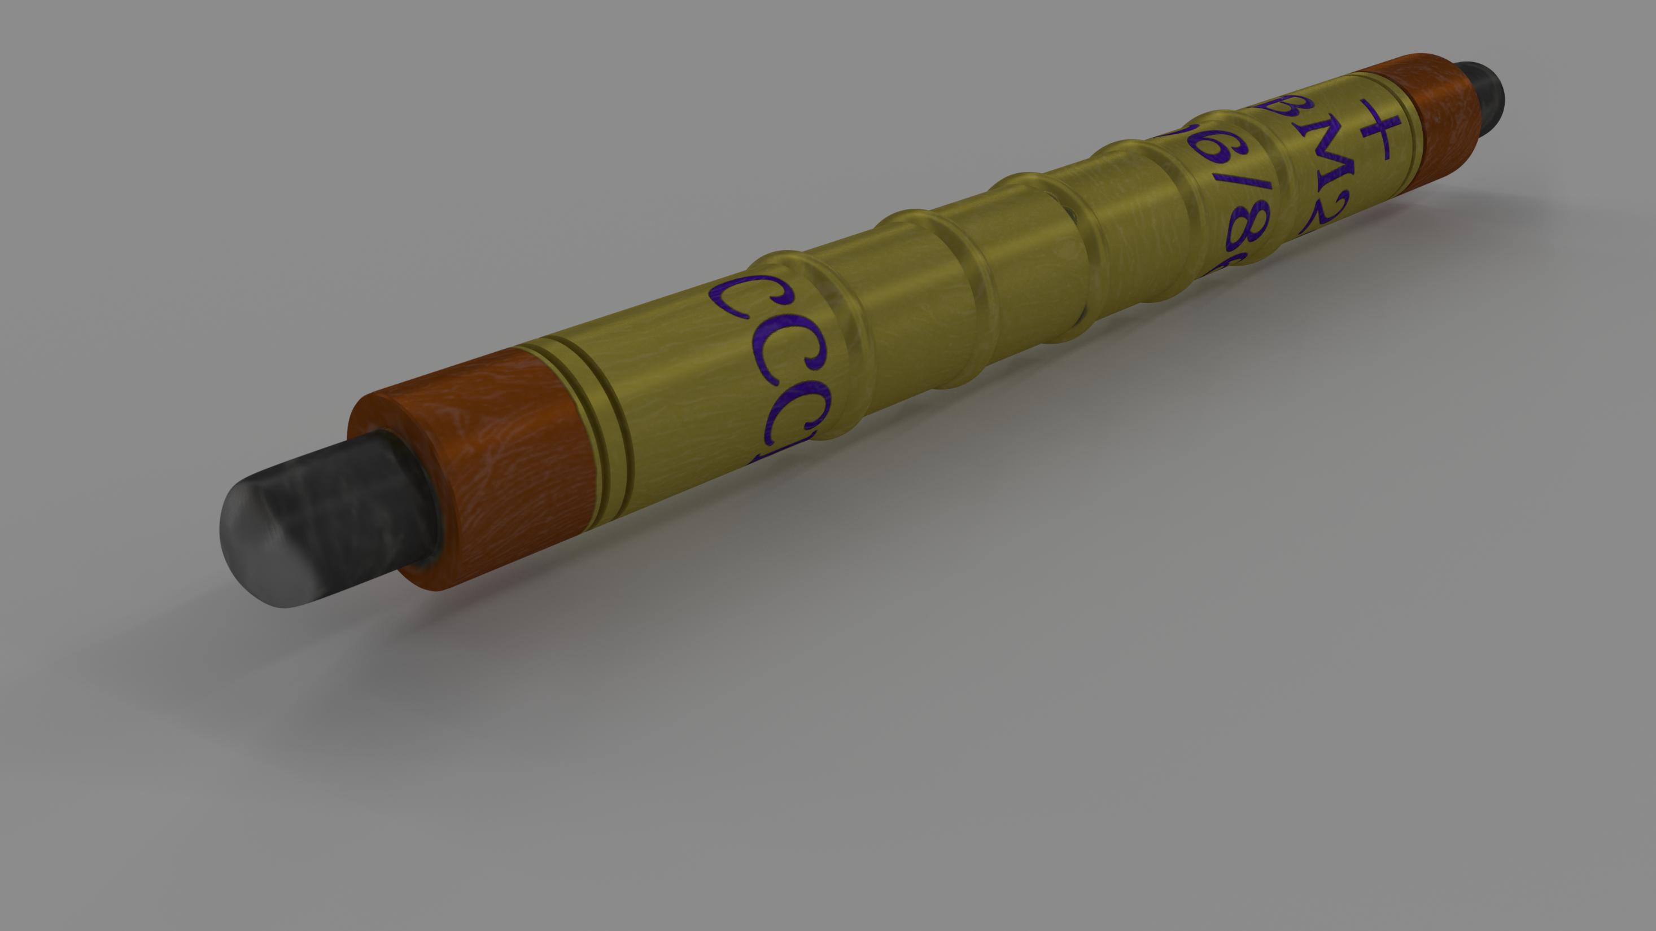
Becoming a Scientist Development of Research Skills through Senior Research Projects
Sawaiz Syed, Dr. Brian Thoms, and Dr. Xiaochun He
Department of Physics & Astronomy, Georgia State University
Notes:
Header footer, side number logo even
Tell story of last year, physics lab, senior research, now show building program, training
Start with the device, start with product, and then show origin story present product of research

Slide 2
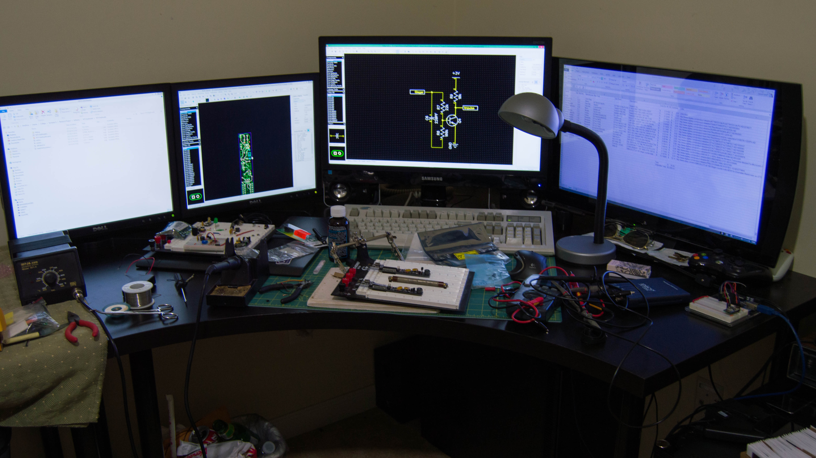
Sawaiz Syed
Notes:
Who am I?

Slide 3
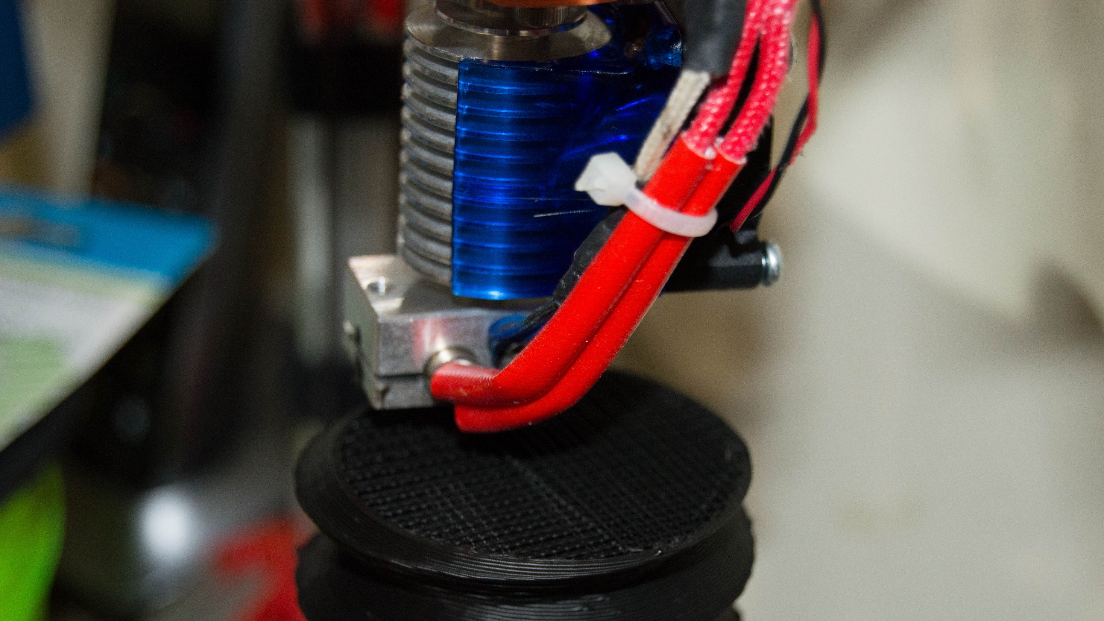
Maker
Notes:
Maker comes close

Slide 4
Tinkerer
Notes:
Tinkerer also works Anything Technical
Fourth Printer

Slide 5
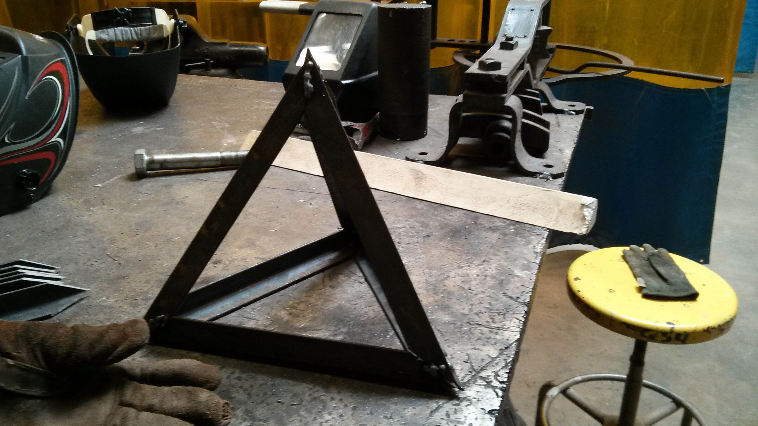
Whatever
Notes:
Anything Vaguely Interesting
Doesn’t Matter What it is, I’ll learn it

Slide 6
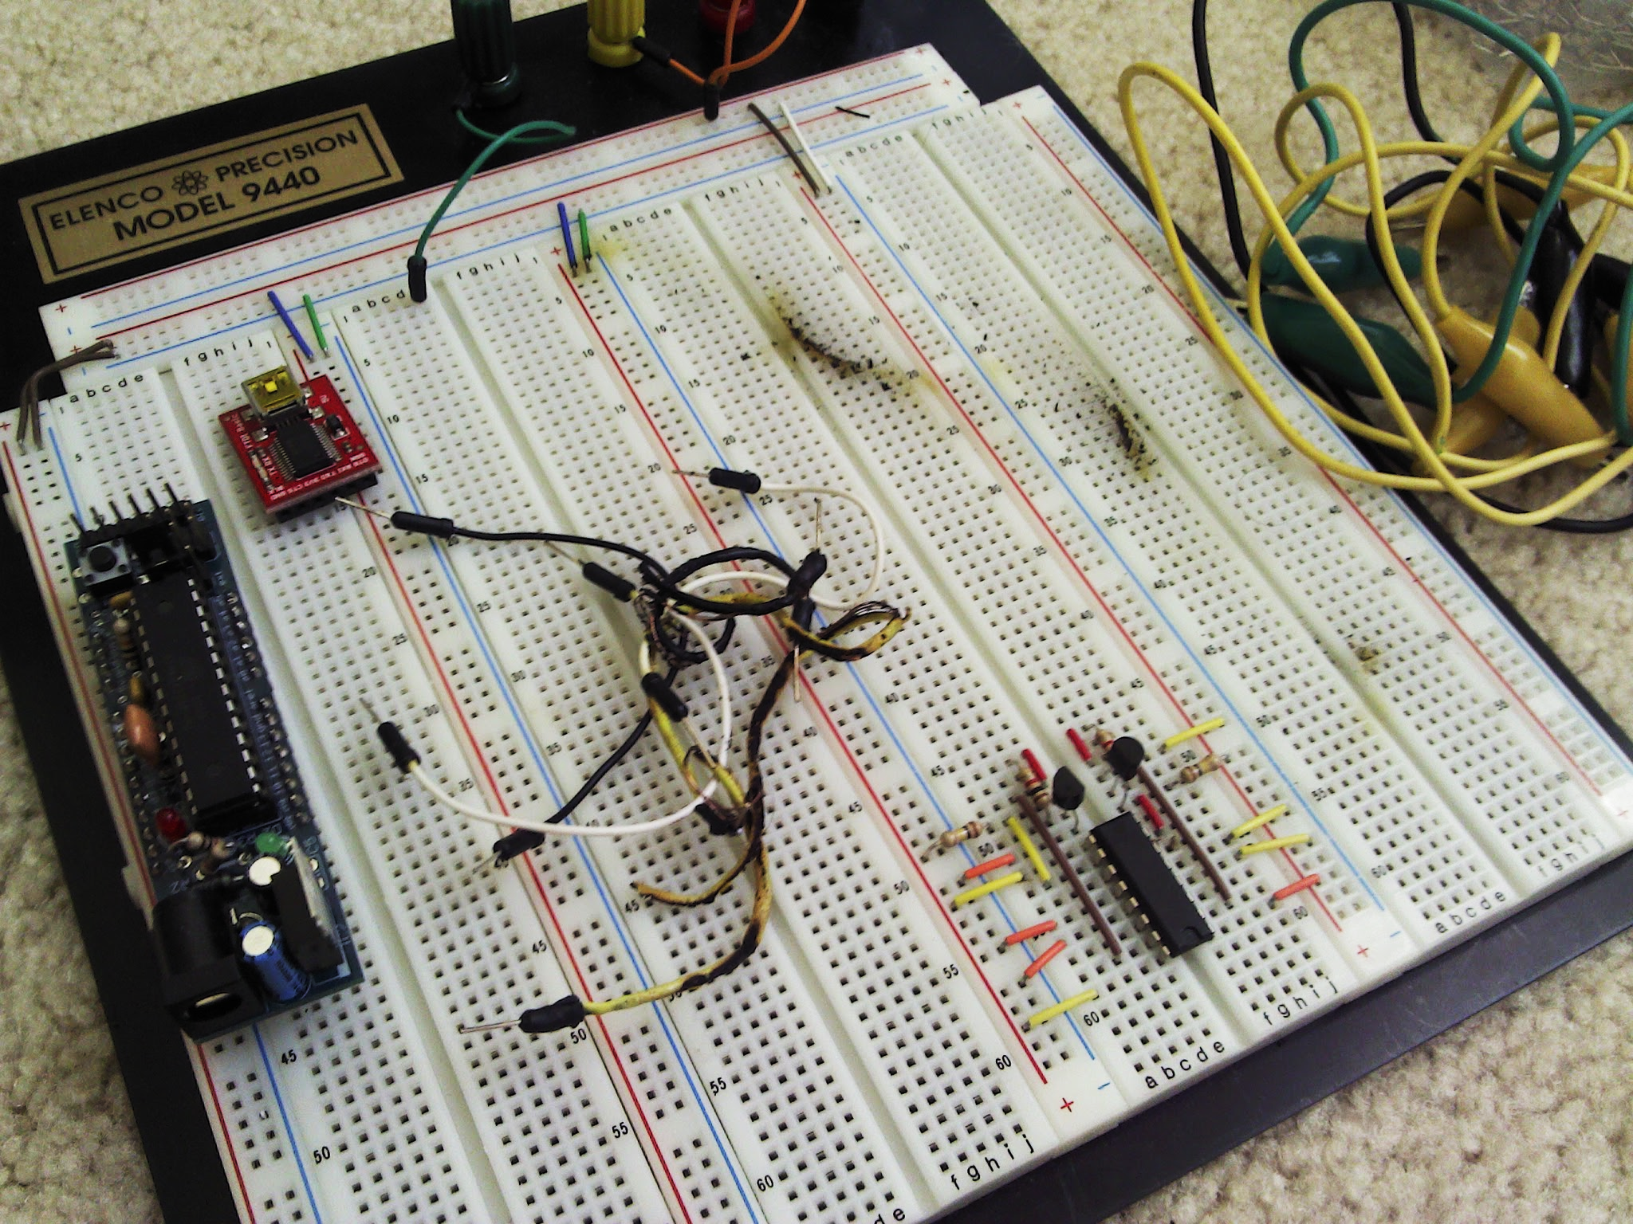
Expertise
Notes:
Expertise lies in electronics
Perhaps this doesn’t show it best
20A in 20GA Wire

Slide 7
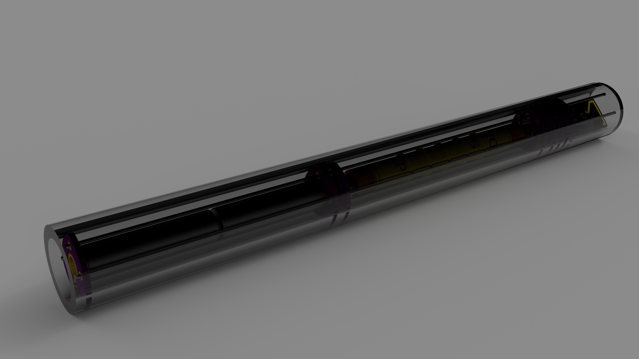
And this is…
Notes:
What did a work on? It was an actual product not just data.

Slide 8
Low Cost Networked Radiation Sensor
Notes:
Clearly See that I’m a hardware person, Or like the smell of burning plastic
Its what I like, and what I have experience with

Slide 9
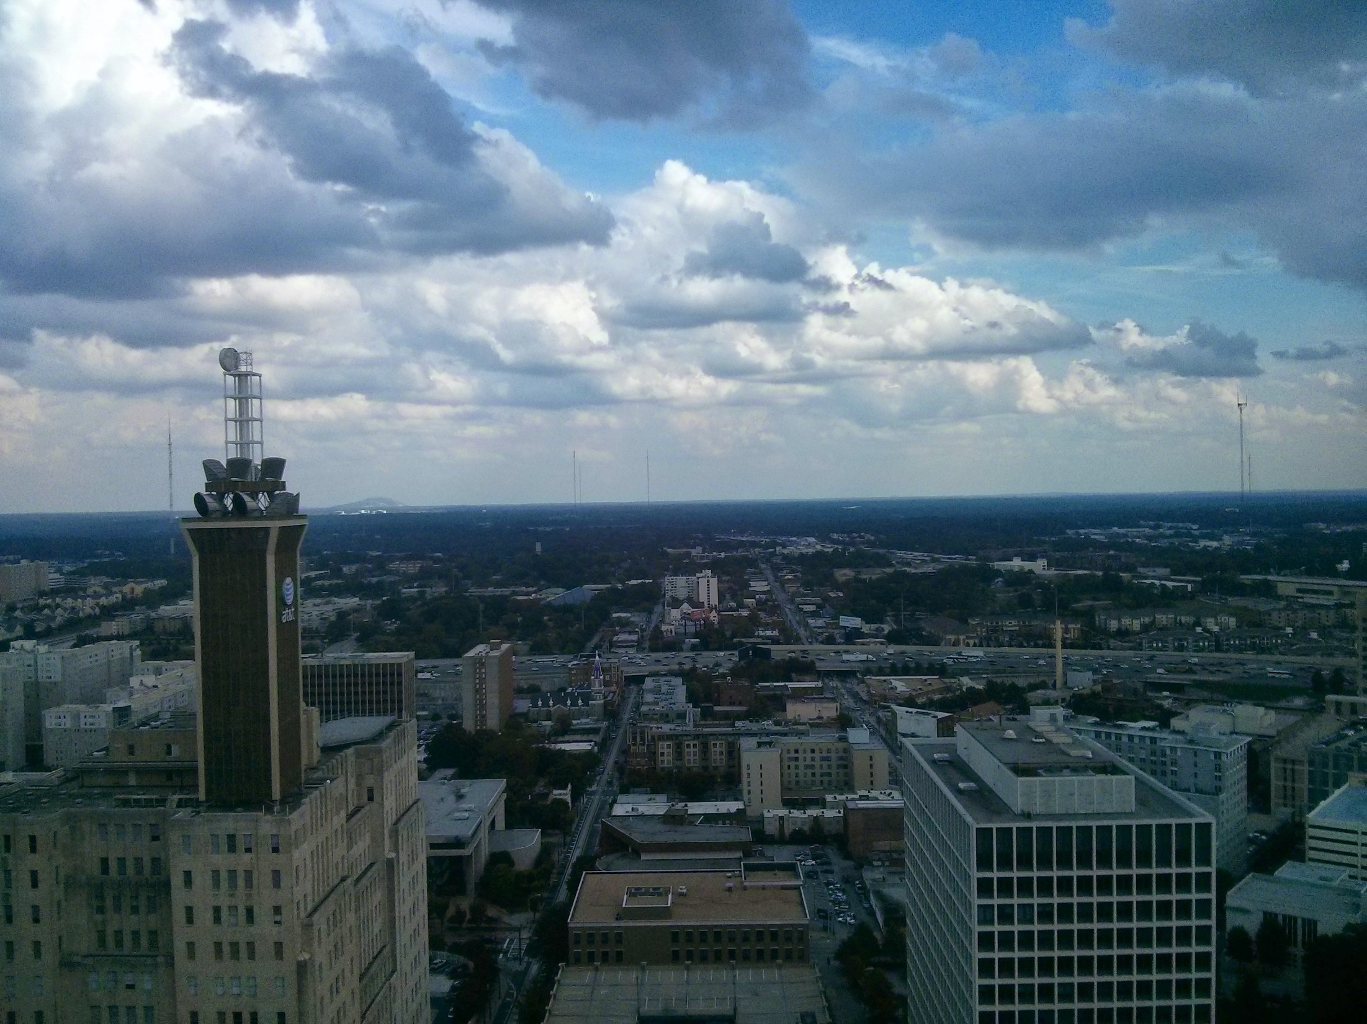
Why
Homeland Security
Notes:
Dirty Bombs
Downtown Atlanta is Dense, Provide Monitoring in cities

Slide 10
Radiation
Safety
Monitoring Systems
Notes:
Lab Monitoring Systems
Such as in a richer environment
Provide first response data
If there is a radiation leak somewhere, or sample not sealed.

Slide 11
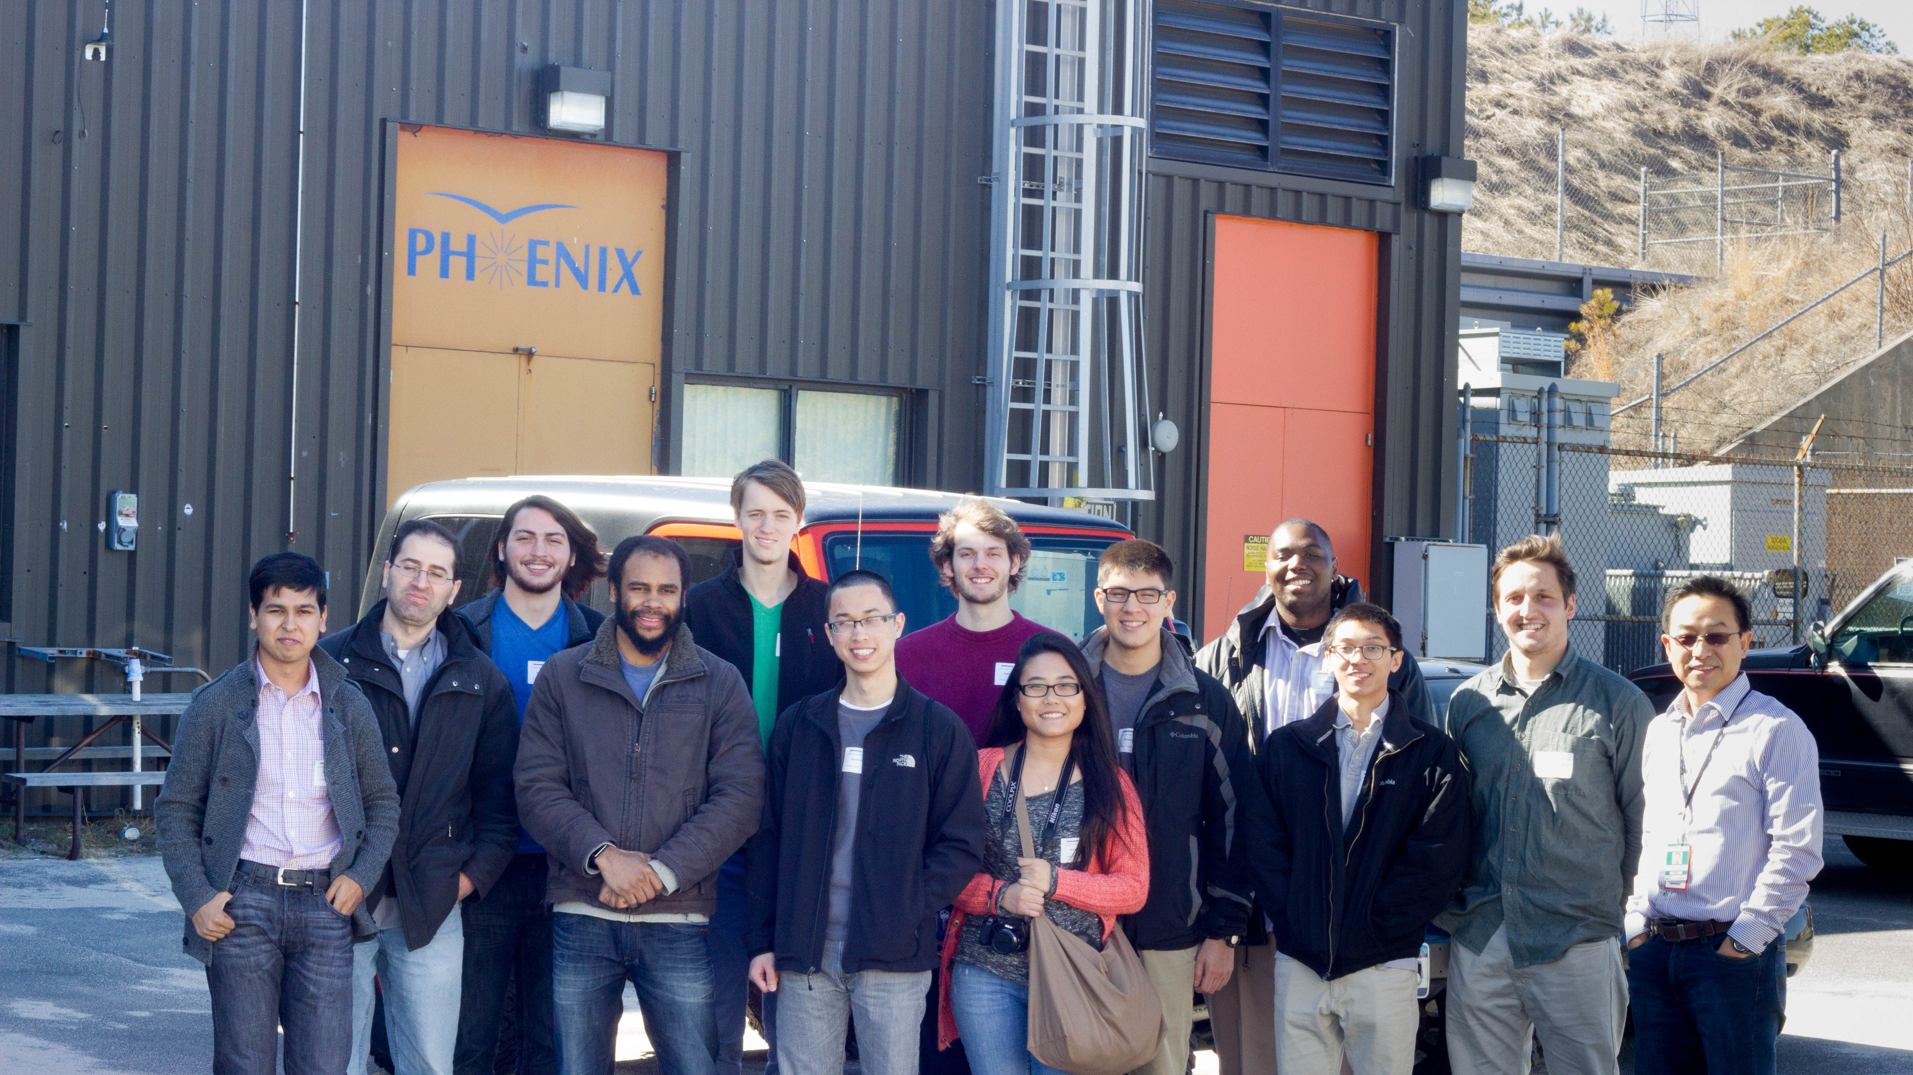
Education
Notes:
Very few tools to teach about radiation
What equipment exists is expensive
Going to Brookhaven, worth it, but expensive
Learn data analysis, see how radiation counts refer to intensity

Slide 12
Advanced Lab
LabView
Linux
Data Acquisition
Technical Writing
Notes:
Basic Skill Training
Introduction to Researchers

Slide 13
Undergraduate Research
Define Goals
Communication
Mentorship
Authentic Research
Notes:
Basic Skill Training
Introduction to Researchers

Slide 14
Low Cost Networked Radiation Sensor
Notes:
Clearly See that I’m a hardware person, Or like the smell of burning plastic
Its what I like, and what I have experience with

Slide 15
Geiger Tube High Voltage Microprocessor Wireless
Notes:
Clearly See that I’m a hardware person, Or like the smell of burning plastic
Its what I like, and what I have experience with

Slide 16
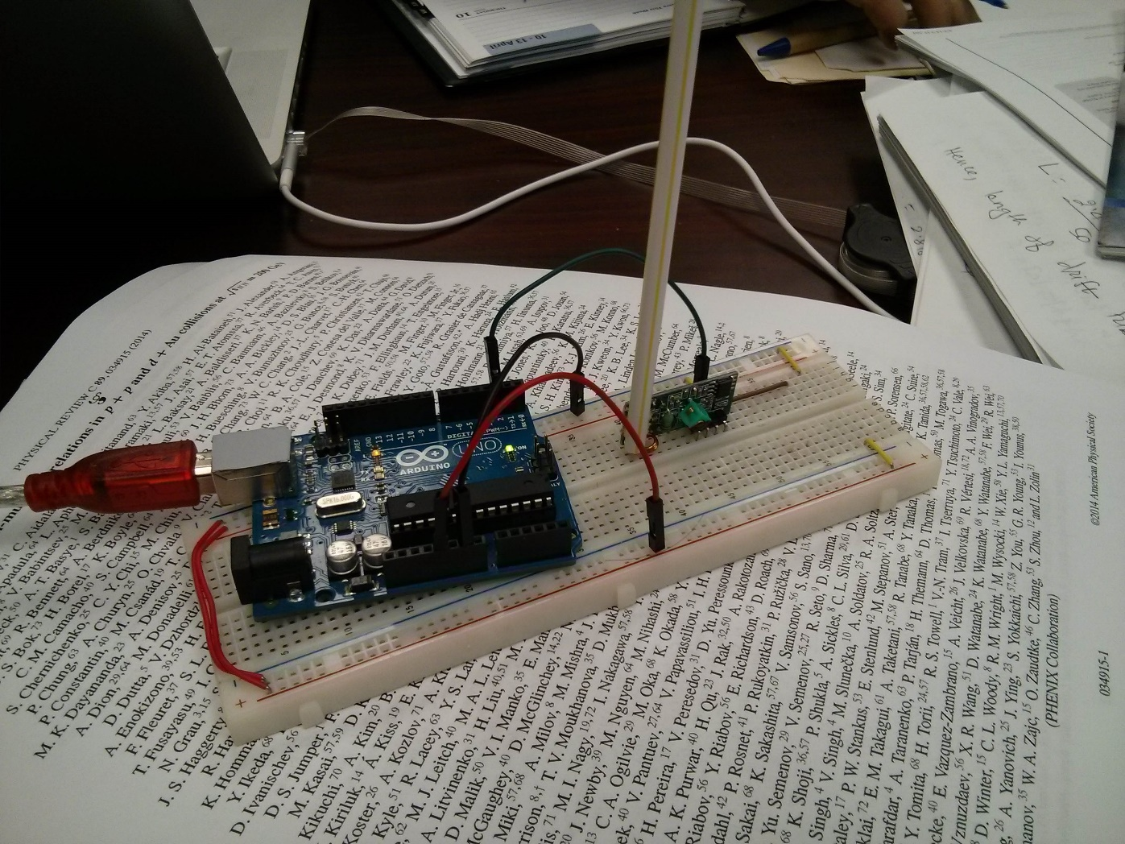
Notes:
First prototype, getting wireless working
Focus on getting things working
Wireless transmitter was cheap, but did not work

Slide 17
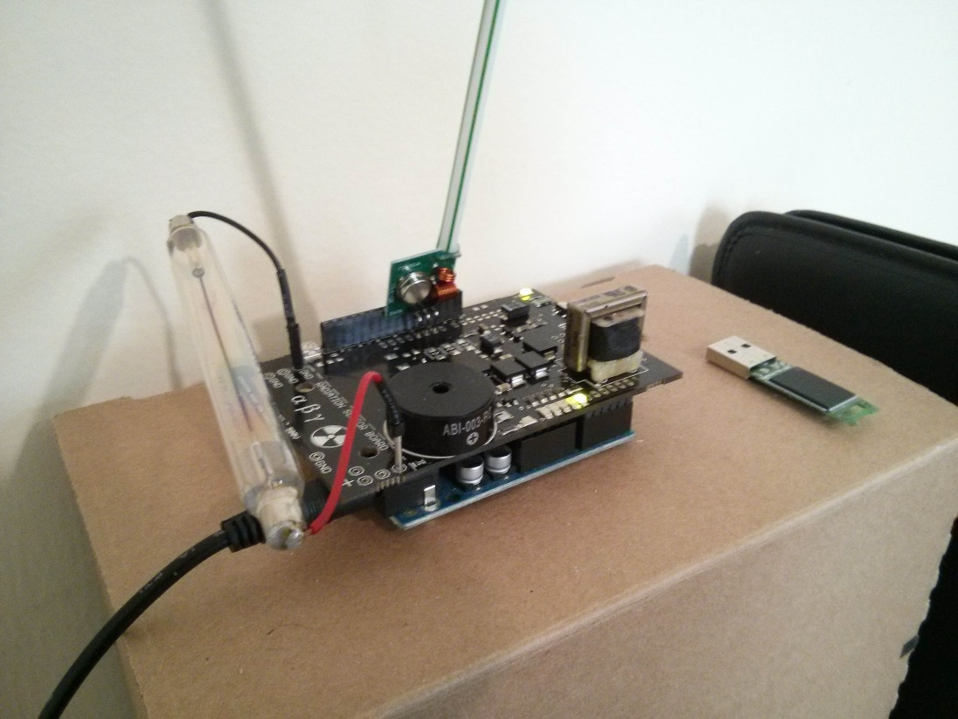
Notes:
Add Geiger counter, shield expensive though
Full proof of concept though, time to cut costs
Cost, $160

Slide 18
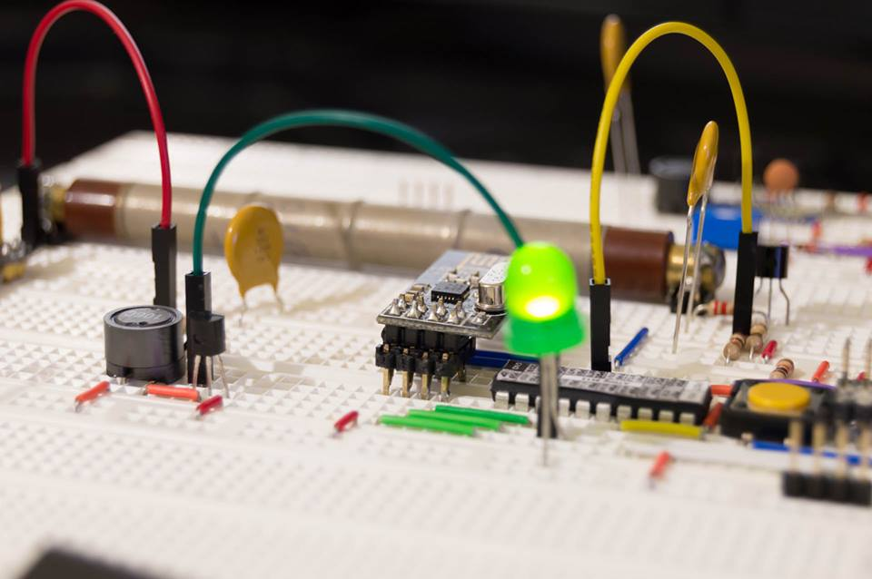
Notes:
Its time to cut costs, cheaper, better wireless transceiver…
Ditch the Arduino, raw chip now, much cheaper, costs $80
Moved to C, learned that in a week, because of clear goals
Learned analog circuits, made cheap fast efficient HV source

Slide 19
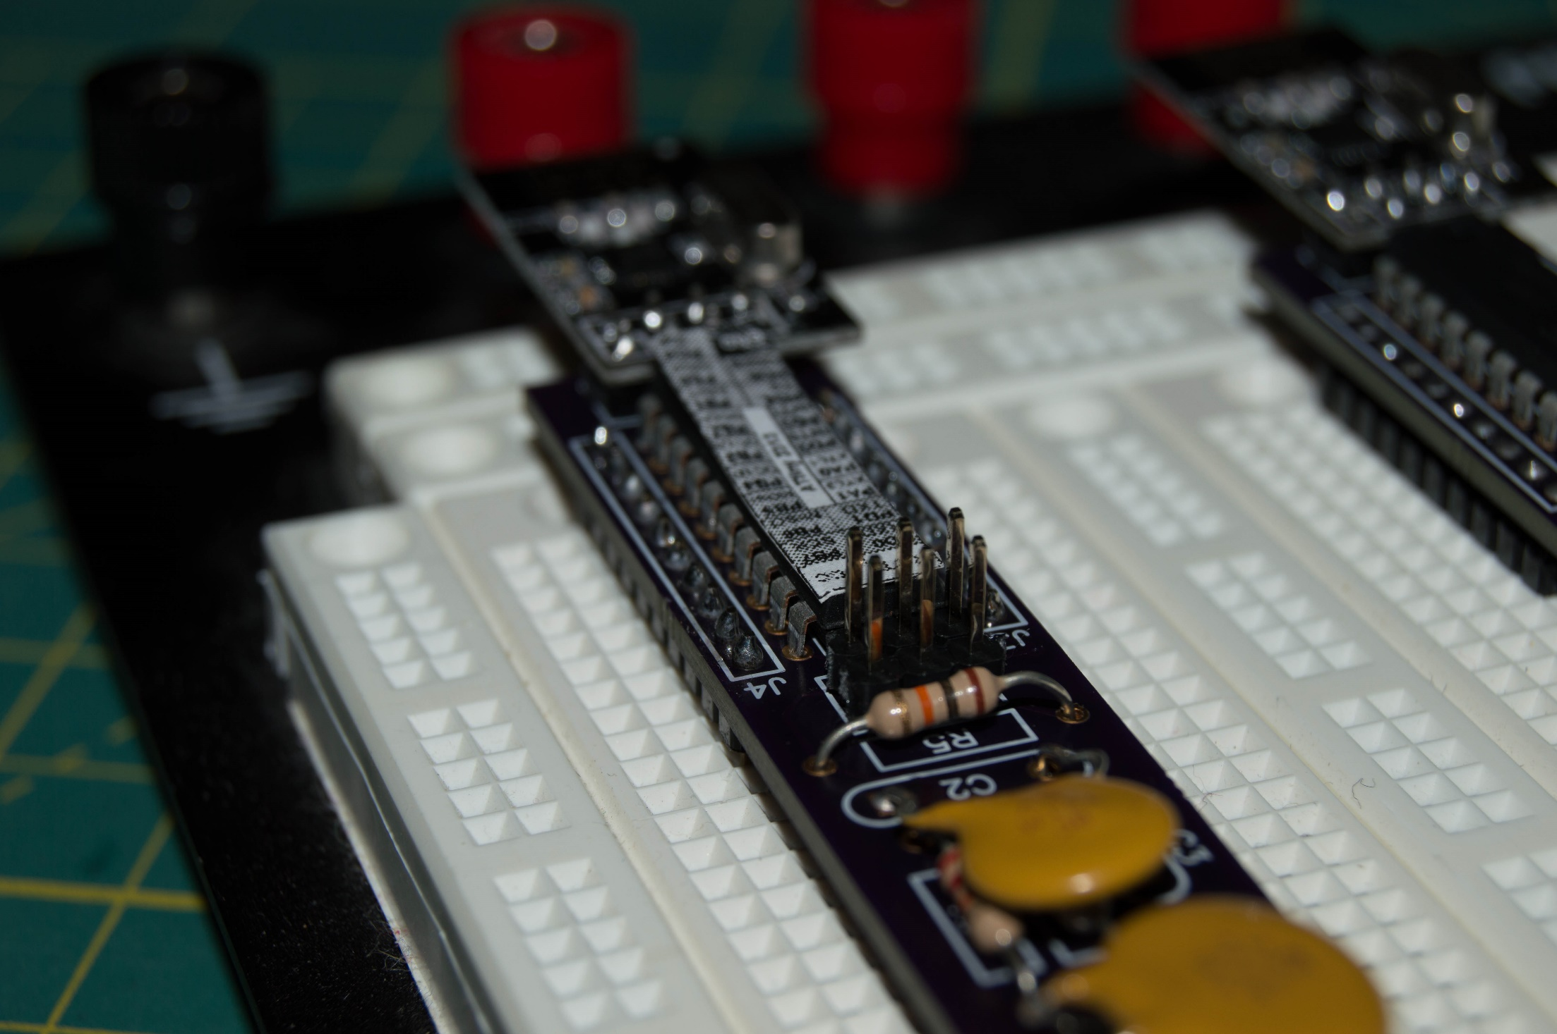
Notes:
What’s next, circuit board, much cheaper, more robust
Made Circuit Boards
Found manufacturers
Honed software, Debugged boards that came in, incorrect trace

Slide 20
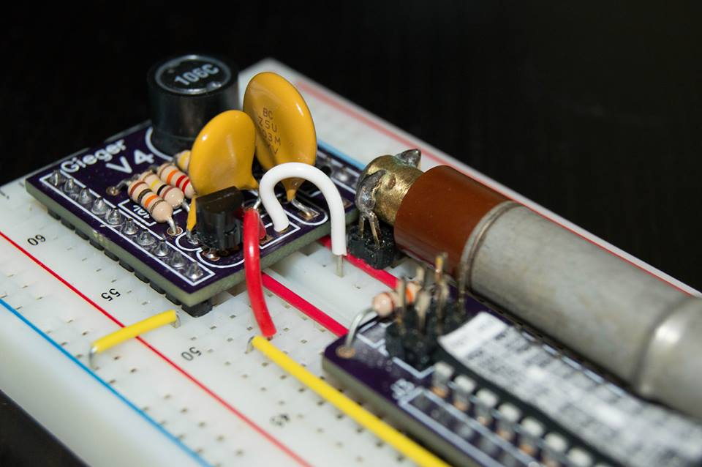
Notes:
Completed MK 6

Slide 21
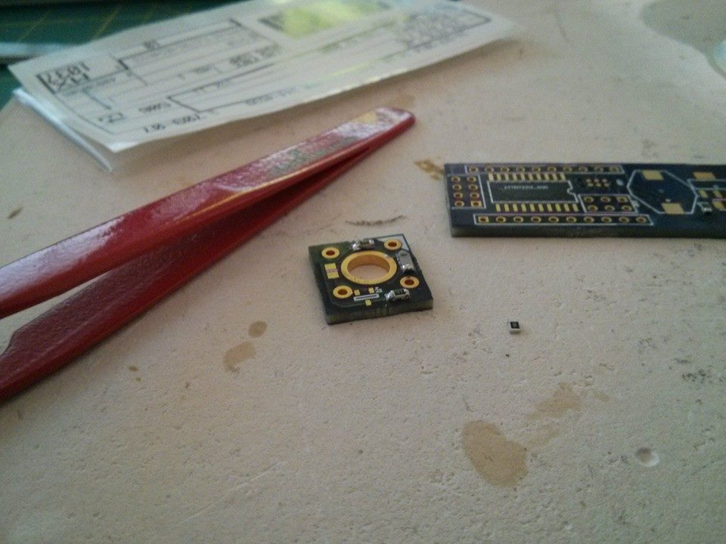
Notes:
Moved to SMD Parts, Never worked with before
Need to cut costs, make it easier to mass produce, and reduce size

Slide 22
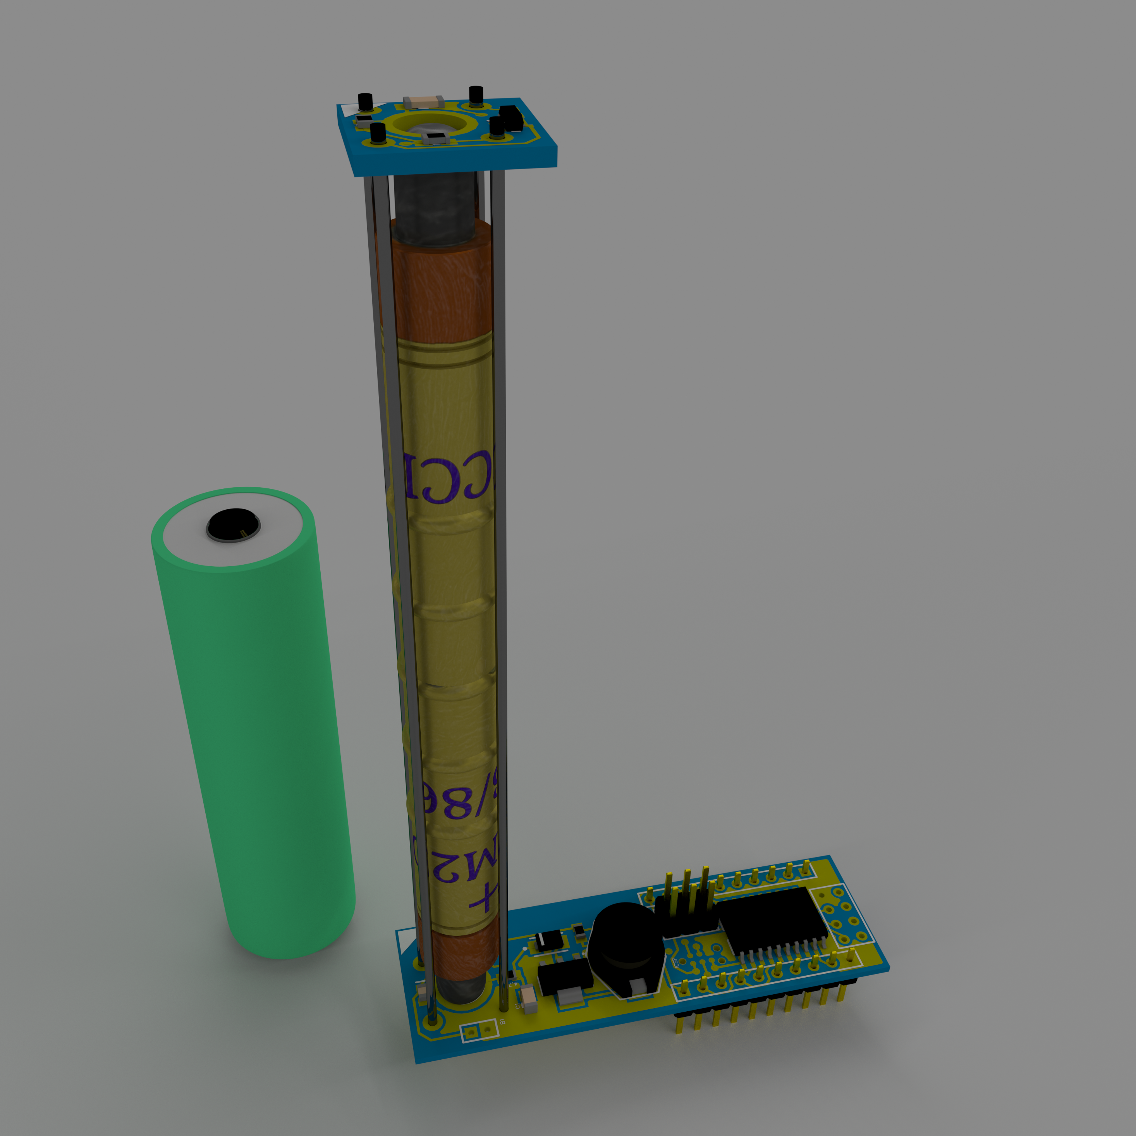
Mk.6
Notes:
Current Generation
Rendering, Great for documentnion
Geiger Tube, HV Supply, Wireless,

Slide 23
N/A
$22
Networked Sensor
Comparable
Hardware
Notes:
Let’s see how it stacks against the competition, nothing in the market
Nothing even close exits

Slide 24
Notes:
Current Generation
Rendering, Great for documentnion
Geiger Tube, HV Supply, Wireless,

Slide 25
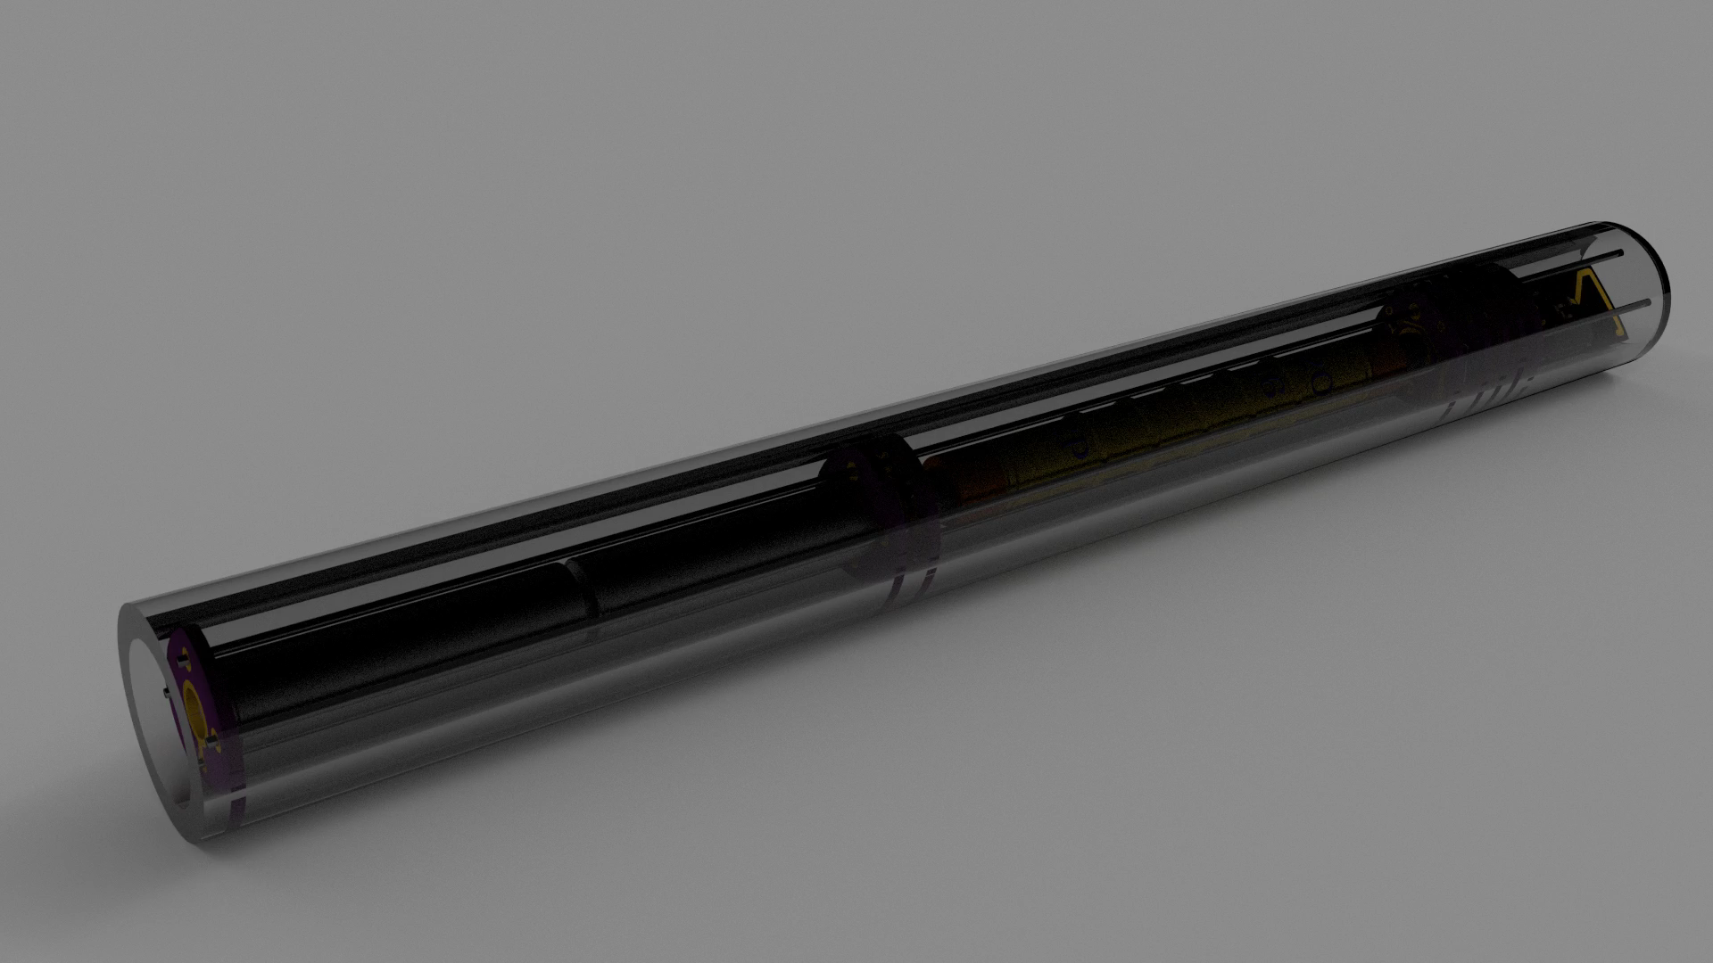

Slide 26
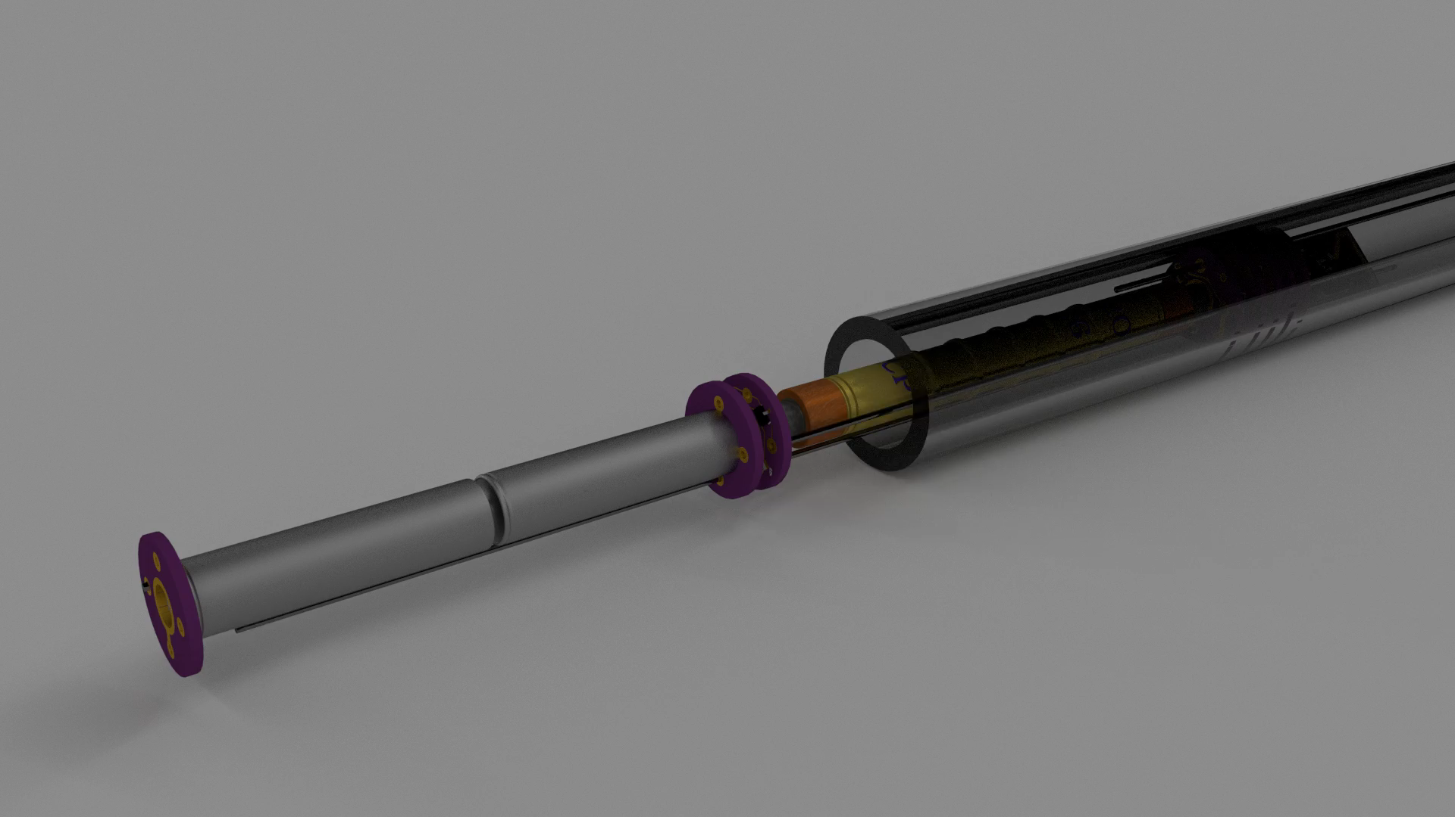

Slide 27
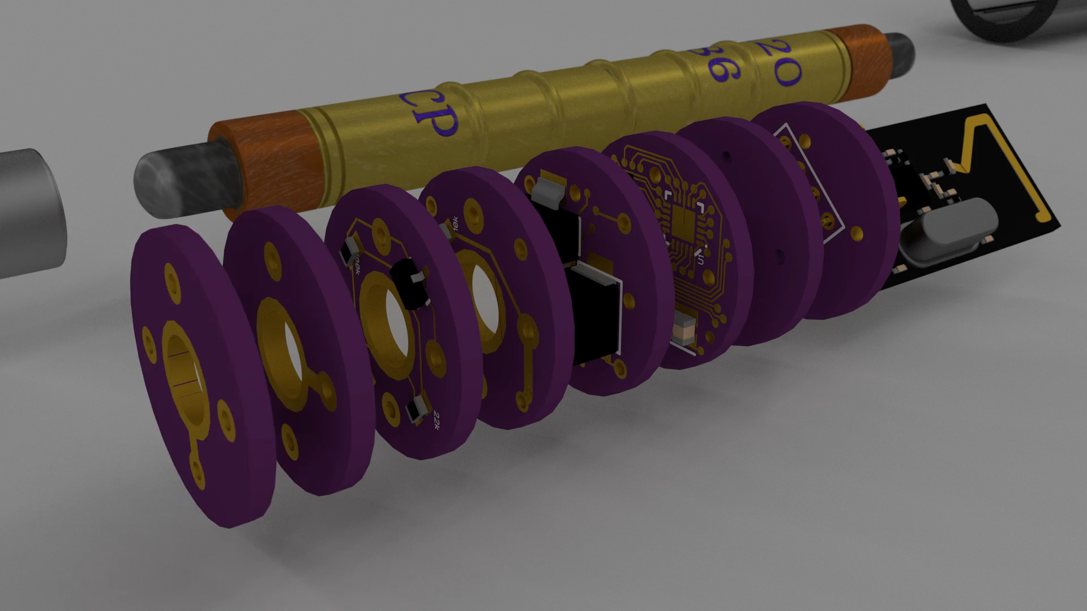

Slide 28
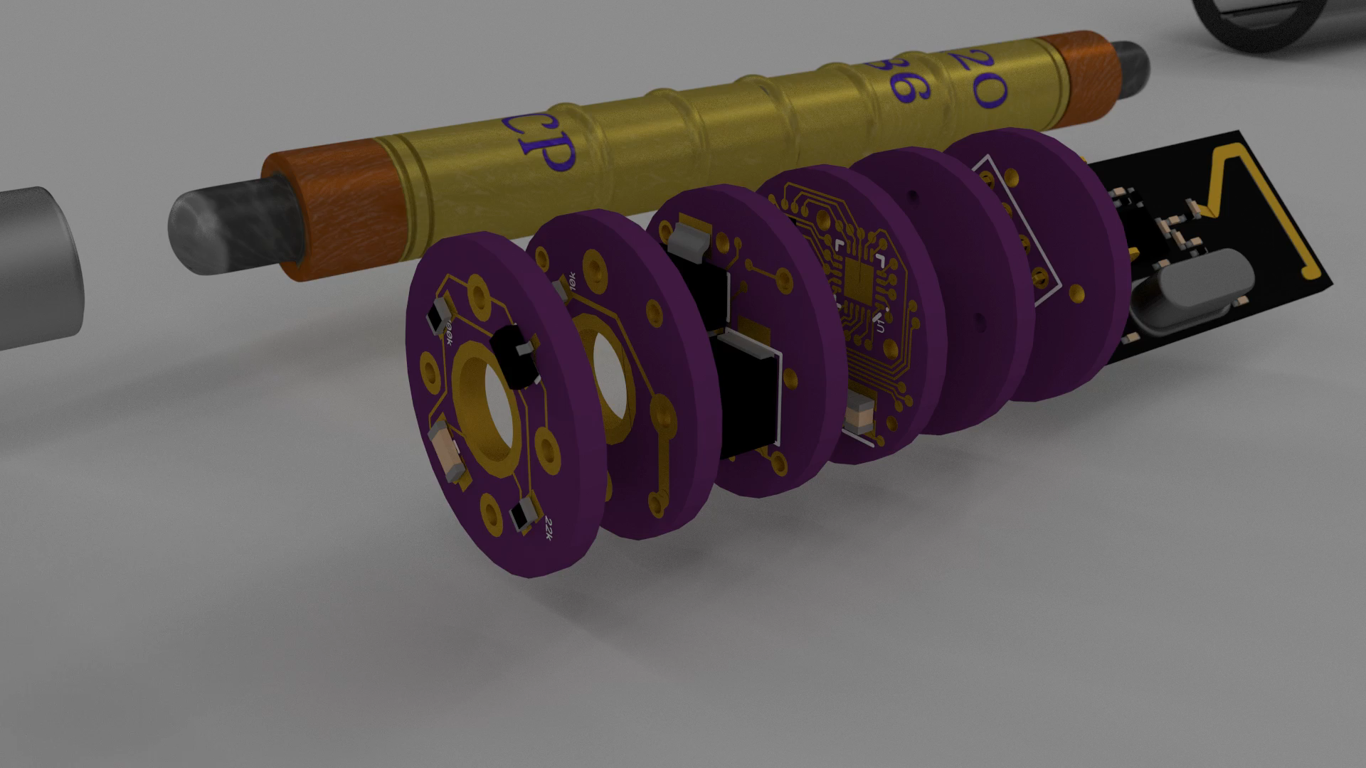

Slide 29
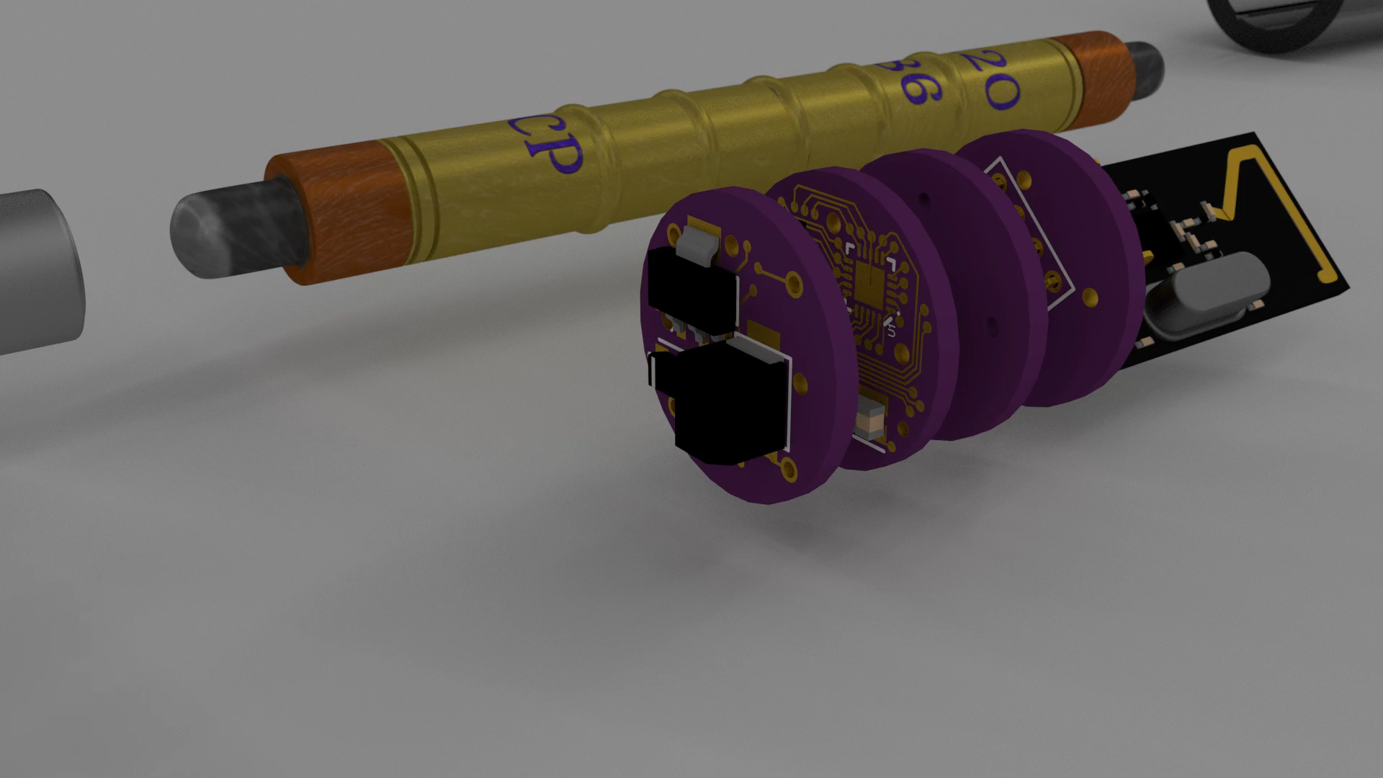

Slide 30
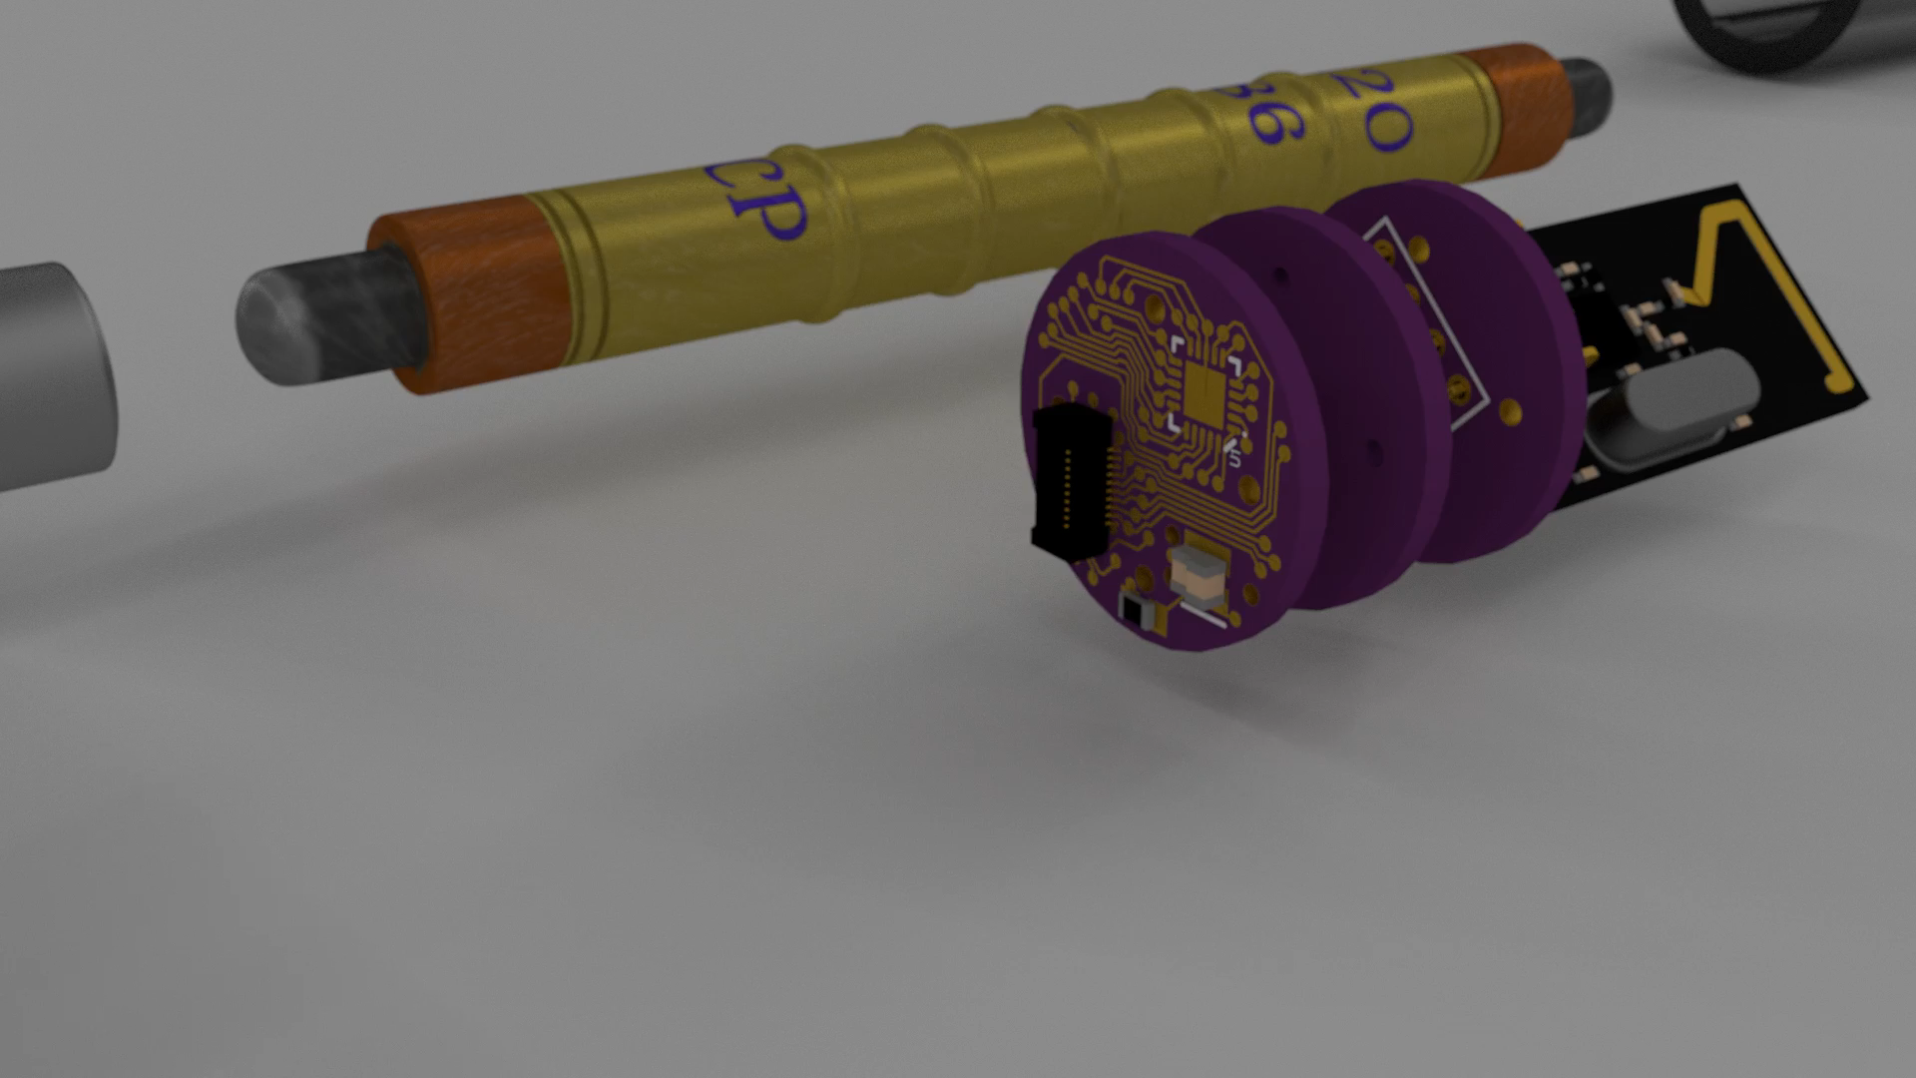

Slide 31
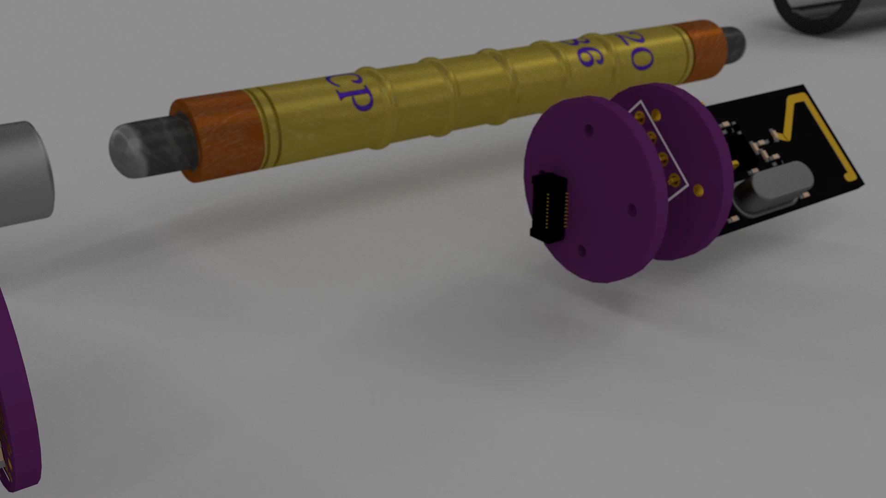

Slide 32
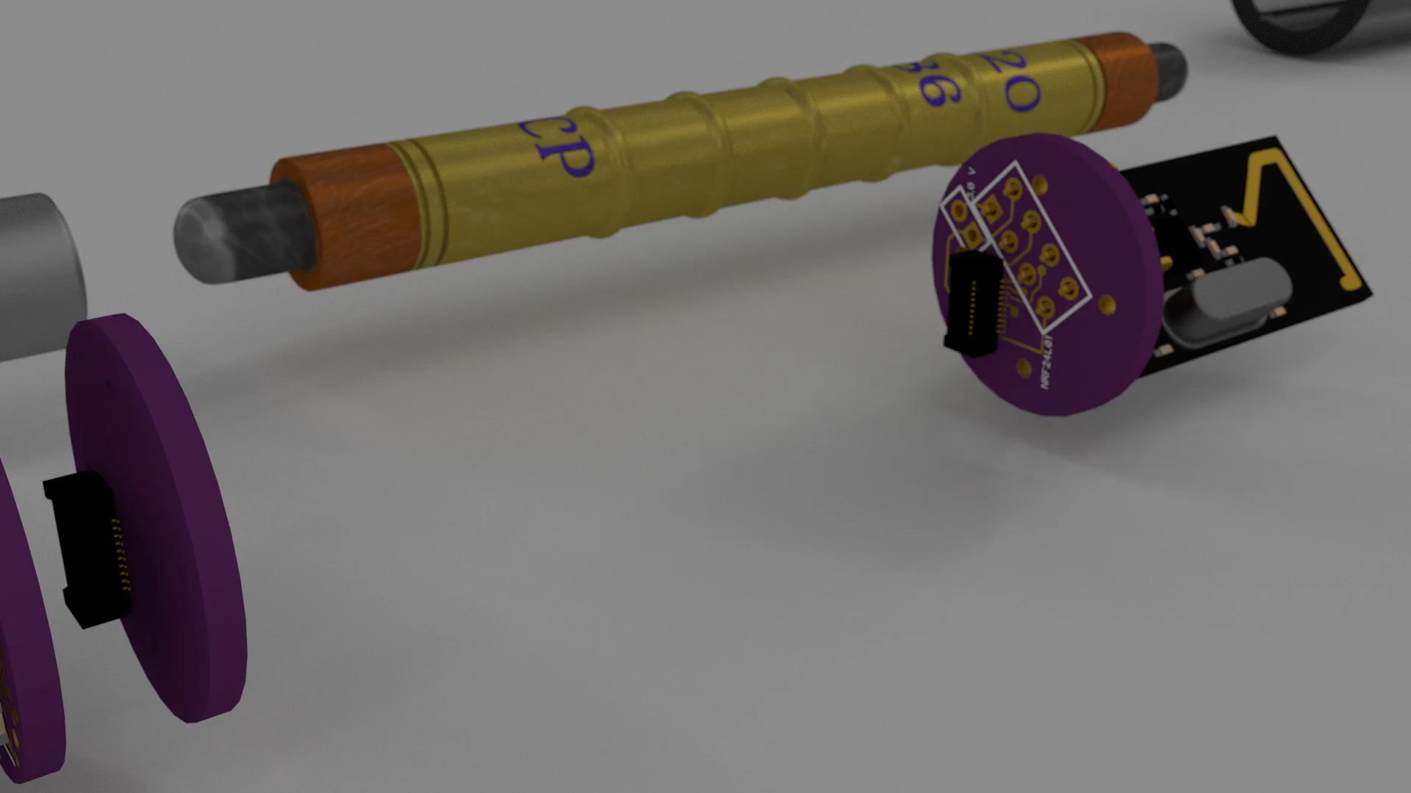

Slide 33
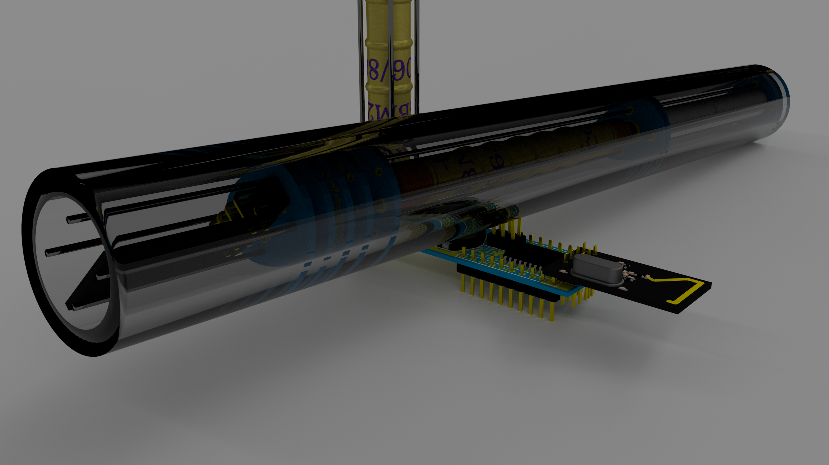
Questions
Sawaiz Syed: asyed5@student.gsu.edu

